Slide 1
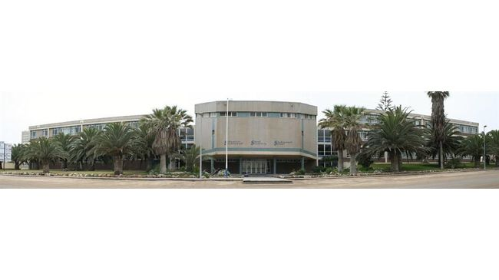
SWAKOPMUND SECONDARY SCHOOL
GRADE 9 COMPUTER STUDIES NOTES
COMMUNICATION AND NETWORKING
Mr Kanhalelo

Slide 2
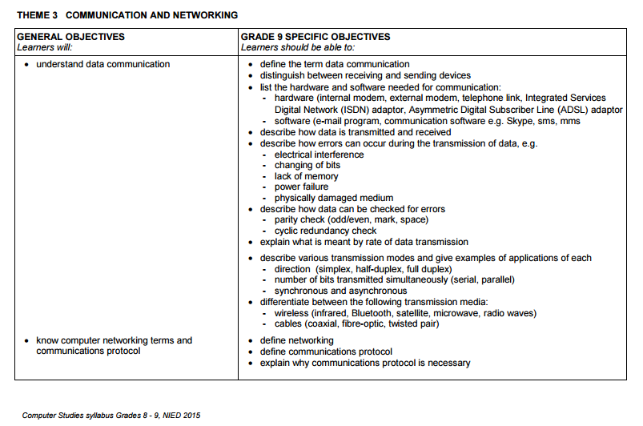

Slide 3
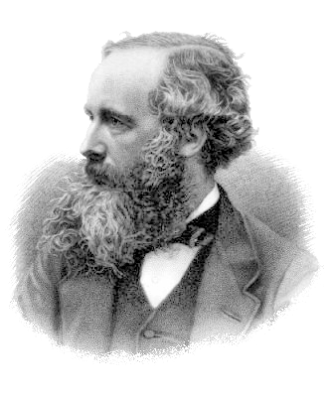
Electromagnetism

Slide 4
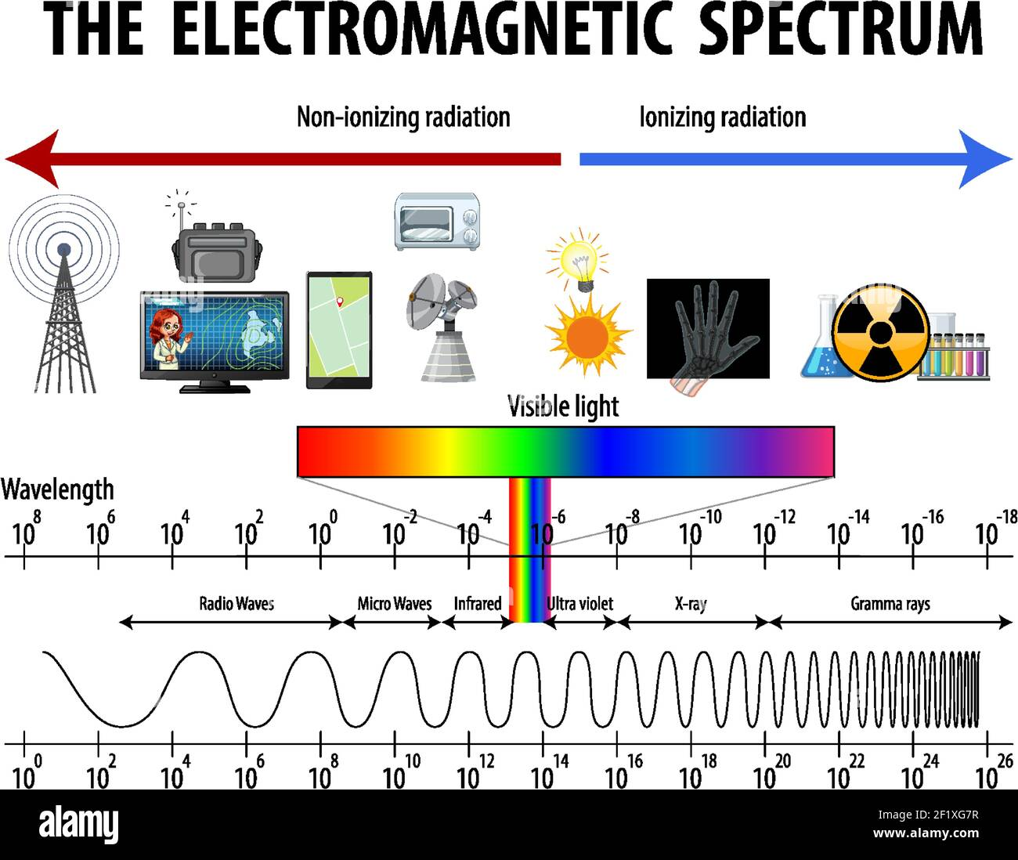

Slide 5
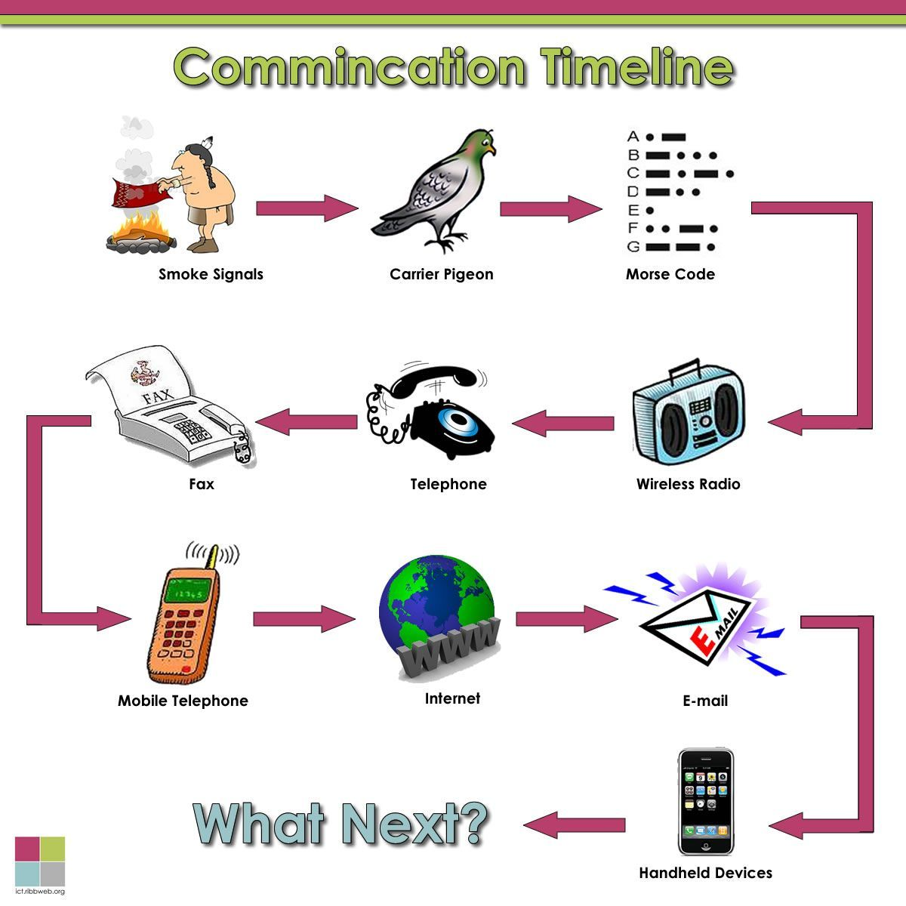

Slide 6
Definition of terms
Computer Communication
describes a process in which two or more computers or devices transfer data, instructions and information.
Data Communication
Refers to the exchange of data between a source(sender) and a receiver.
Different forms of communications
Cables connections
Wires connections
Wireless connections

Slide 7
What is needed for effective communication?
A sending device
Used to send data, instructions or information
A communication device
It connects a sending device to a communication channel
A communication Channel
Used as a carrier for data, instructions or information
Another communication device
To connect the communication channel to a receiving device
A receiving device
Receives and acceptes the transmission of data, instructions or information.

Slide 8
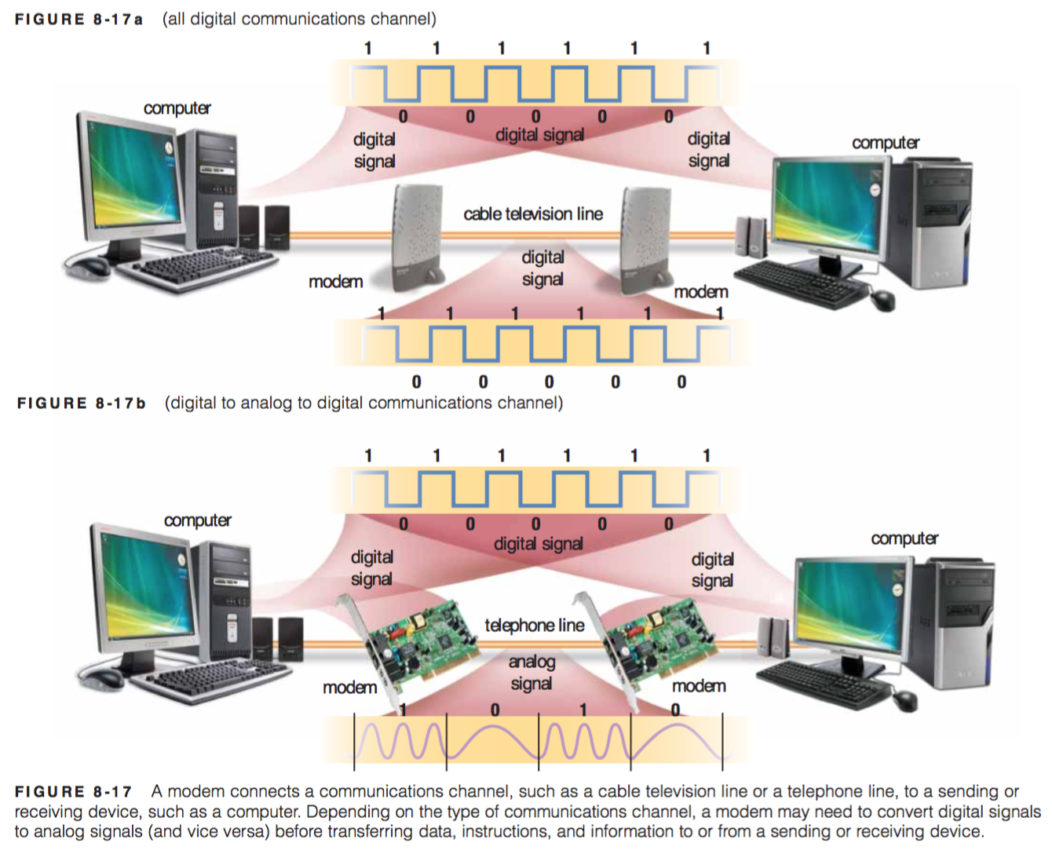

Slide 9
Hardware and Software needed for communication

Slide 10



Communication Software.
Are programs which help users establish a connection to another computer or network.
The manage the transmission of data, instructions and information and,
Provide an interface for users to communicate with one another.
Examples
Email Program
Commu

Slide 11
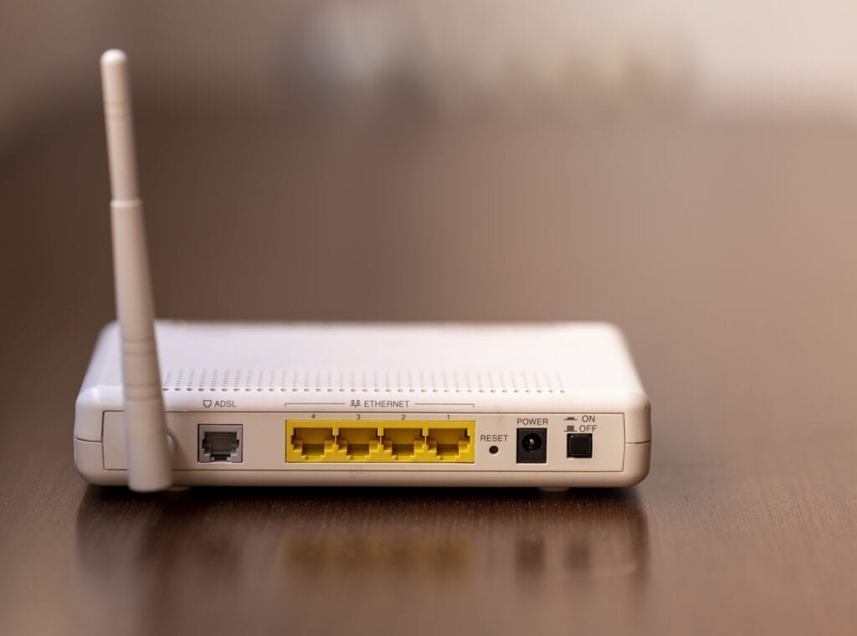
Communication Hardware.
A communication device is any type of hardware designed to transfer information or data from from one place to another.
The allow computers to communicate with one another.
Examples
An External modem

Slide 12
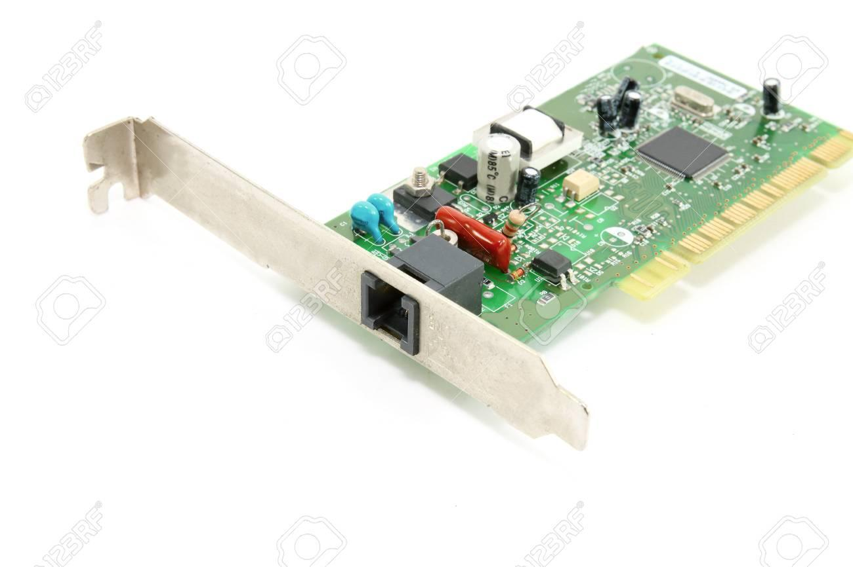
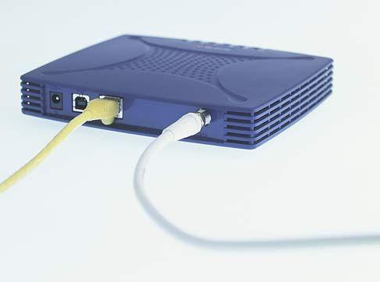
Types of Modems
Internal Modem
External Modem

Slide 13
Digital Modems: ISDN & DSL
Digital Modems send and receive data and information to and from a digital line
ISDN - Integrated Services Digital Network
Sends digital data and Information from a computer to an ISDN line and receives digital data and information from an ISDN line.
DSL - Digital Subscriber Line
sends digital data and information from a computer to a DSL line and receives digital data and information from a DSL line

Slide 14
Dial-up Modems
A dial-up modem is a communication device which converts digital signals to analogue signals and analogue signals to digital signals so that data can travel along an analogue telephone line.
ISDN - Integrated Services Digital Network
Sends digital data and Information from a computer to an ISDN line and receives digital data and information from an ISDN line.
DSL - Digital Subscriber Line
sends digital data and information from a computer to a DSL line and receives digital data and information from a DSL line

Slide 15
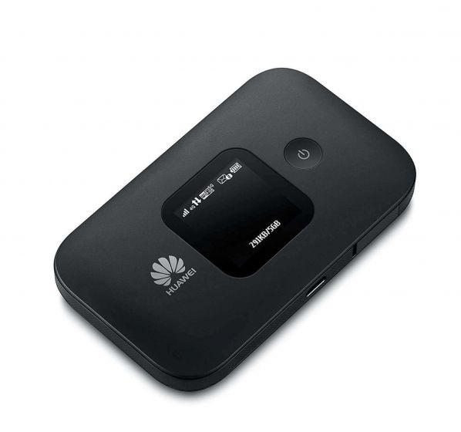
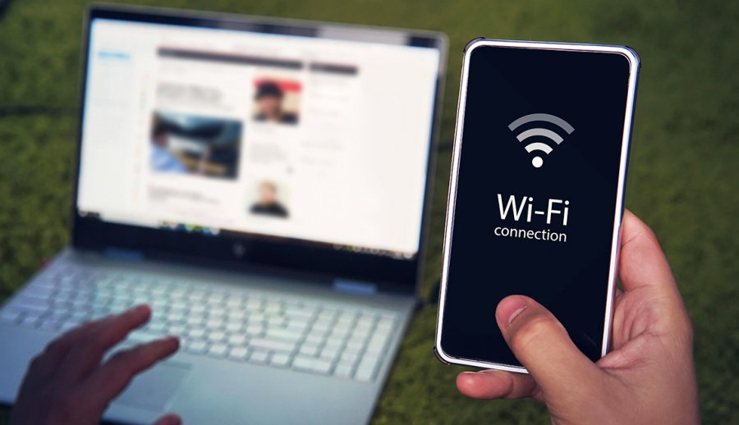
Dial-up Modems
A dial-up modem is a communication device which converts digital signals to analogue signals and analogue signals to digital signals so that data can travel along an analogue telephone line.
Wireless Modem
Is a modem that bypasses the telephone system and connects directly to a wireless network, through which it can directly access the Internet connectivity provided by an Internet service provider (ISP).

Slide 16
How data is transmitted over the internet?

Slide 17
THANK YOU

